Slide 1
Discuss the major industries in bangladesh
Textiles and Garments.
Agriculture.
Pharmaceuticals.
Information and Communication Technology (ICT).
Leather and Leather goods.
Shipbuilding.
Tourism.

Slide 2
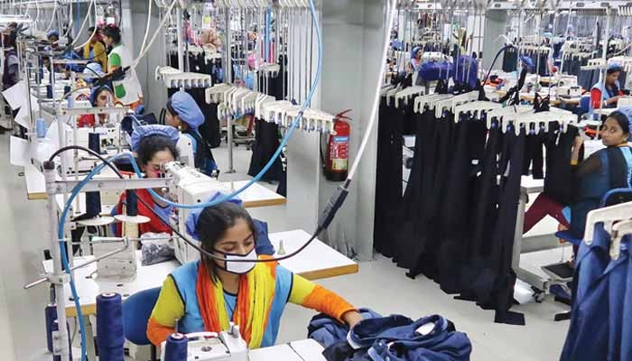
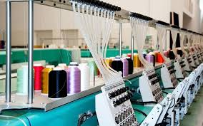
1. Textiles and garments.

Slide 3
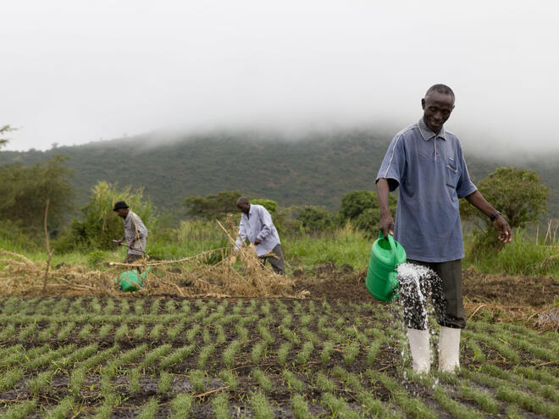
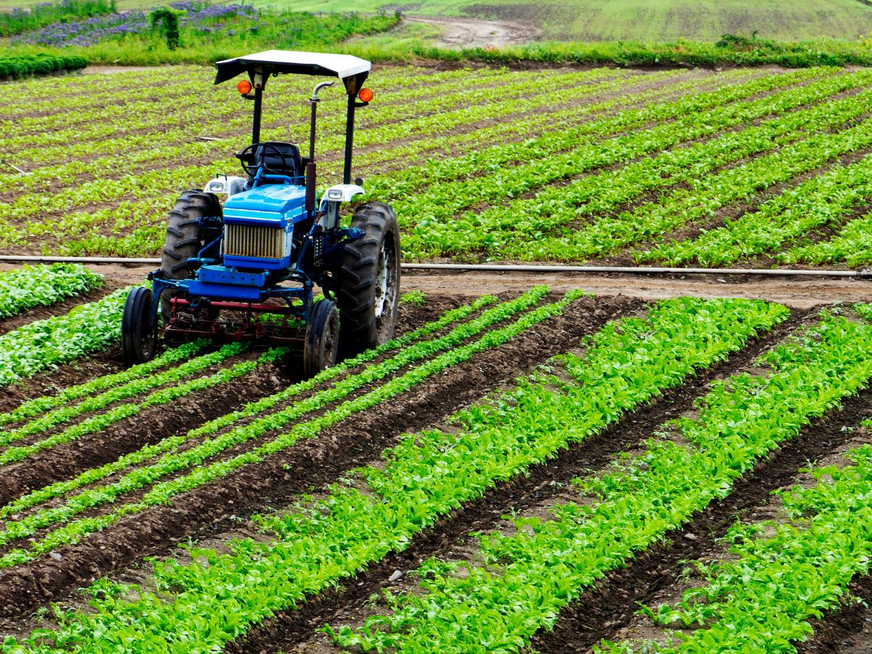
2. Agriculture.

Slide 4


3. Pharmaceuticals.

Slide 5






4. Information and communication technology (ict).

Slide 6
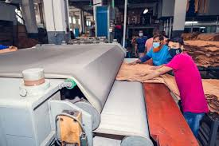
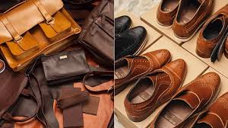
5. Leather and leather goods.

Slide 7
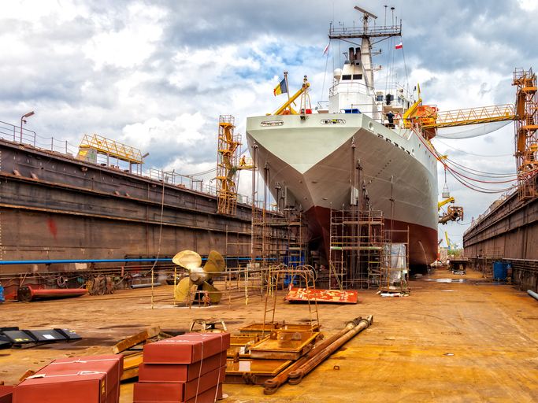
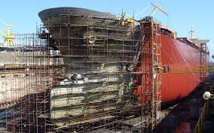
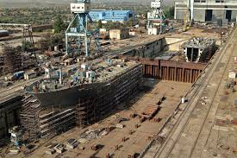
6. shipbuilding.

Slide 8
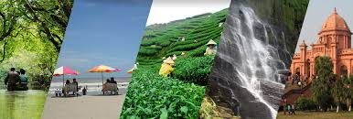

7. tourism.

Slide 9
*Thank you everyone*

